Slide 1
Exploring Network Security with Python and Nmap
By: Nicholas Fisher

Slide 2
Objectives
Learn about Network Reconnaissance:
Understand the importance of gathering information about a target network and how it aids in identifying vulnerabilities.
Introduction to Ethical Hacking:
Explore the concept of ethical hacking and how it differs from malicious hacking.
Python and Nmap:
Gain insights into Python packages and tools like Nmap used in ethical hacking practices.

Slide 3

Link to our Course GitHub
Github : https://github.com/FishyStix12/BH.py-CharCyCon2024/tree/main

Slide 4

What is Network Reconnaissance?
Definition:
Network reconnaissance involves actively gathering information about a target network to understand its structure, services, and potential vulnerabilities.
Importance:
It allows security professionals to assess the security posture of a network and identify potential entry points for attackers.
Techniques:
Network reconnaissance techniques include port scanning, banner grabbing, packet sniffing, and vulnerability scanning.

Slide 5

Introduction to Nmap
Overview:
Nmap, short for Network Mapper, is a widely-used open-source tool for network exploration and security auditing.
Features:
Nmap offers features such as port scanning, service version detection, OS detection, and scripting capabilities, making it a versatile tool for network analysis.
Applications:
It is used by network administrators, security professionals, and ethical hackers for network troubleshooting, vulnerability assessment, and penetration testing.

Slide 6

Understanding the Python Nmap Script net_terrorizer.py
Description of this Script:
This Python script offers a flexible solution for performing targeted Nmap network scans, allowing users to customize their scanning process through interactive prompts. Users can input a list of remote IP addresses or CIDR notations, along with a specific port range or a full port scan. The script guides users through selecting various Nmap scripts—each with a brief description of its functionality—such as detecting honeypots, analyzing firewall rules, or enumerating services and vulnerabilities. After constructing the Nmap command with the selected options, the script executes the scan and provides detailed results, including any identified CVEs and Metasploit modules. Users are given the option to save these results to a user-specified text file, enhancing the script's utility for comprehensive network analysis and documentation. This approach ensures that users can tailor their scans to specific needs while maintaining a detailed record of the scan outcomes.

Slide 7
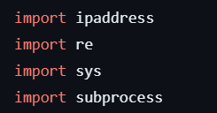
Python Libraries Used
ipaddress:
Purpose: Provides classes to represent and manipulate IP addresses and networks.
Usage: Used for parsing and validating IP addresses and CIDR notations in the script.
re (Regular Expression):
Purpose: Provides support for regular expressions (RE).
Usage: Employed for pattern matching and extraction of CVEs and Metasploit modules from Nmap scan results.
sys:
Purpose: Provides access to some variables used or maintained by the Python interpreter and to functions that interact strongly with the interpreter.
Usage: Utilized for handling script exit conditions and printing error messages.
subprocess:
Purpose: Allows the creation of new processes, connects to their input/output/error pipes, and obtains their return codes.
Usage: Used to execute Nmap commands from within the Python script and capture their output.

Slide 8
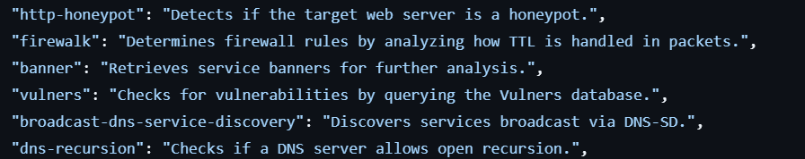
Available Nmap Scripts
http-honeypot description:
Detects if a web server is a honeypot
Firewalk description:
Determines firewall rules by analyzing packet TTL
Banner description:
Retrieves service banners for analysis
Vulners description:
Checks for vulnerabilities using the Vulners
databasebroadcast-dns-service-discovery description:
Discovers services broadcast via DNS-SD
dns-recursion description:
Checks if a DNS server allows open recursion.

Slide 9
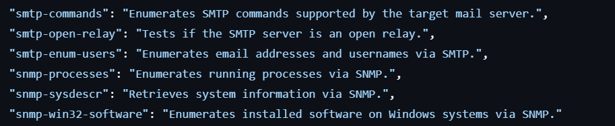
Available Nmap Scripts Continued
smtp-commands description:
Enumerates SMTP commands supported by the mail server.
smtp-open-relay description:
Tests if an SMTP server is an open relay.
smtp-enum-users description:
Enumerates email addresses and usernames via SMTP.
snmp-processes description:
Enumerates running processes via SNMP.
snmp-sysdescr description:
Retrieves system information via SNMP.
snmp-win32-software description:
Enumerates installed software on Windows systems via SNMP.

Slide 10

But Why are some these important?

Slide 11

Enhanced Vulnerability Detection
Identifying Weaknesses
Targeted Vulnerability Checks:
Examples: vulners, smtp-enum-users
Purpose: Detect specific vulnerabilities or weaknesses in services and applications.
Importance: Allows hackers to find and exploit security flaws that could lead to unauthorized access.

Slide 12

Service Enumeration
Gathering Information
Service and Version Detection:
Examples: banner, smtp-commands
Purpose: Retrieve detailed information about services and their versions running on the target.
Importance: Enables hackers to identify outdated or vulnerable software versions that can be exploited.

Slide 13

Firewall and IDS Evasion
Bypassing Security Mechanisms
Firewall and IDS Evasion:
Examples: firewalk, badsum
Purpose: Analyze and bypass firewall rules or Intrusion Detection Systems (IDS).
Importance: Helps hackers evade detection and gain unauthorized access by circumventing network defenses.

Slide 14

Network Discovery
Service and Network Discovery:
Examples: broadcast-dns-service-discovery, dns-recursion
Purpose: Discover services and resources within a network or across networks.
Importance: Provides hackers with a map of the network, identifying potential targets for further attacks.

Slide 15

Honeypot Detection
Avoiding Fake Targets Detecting Honeypots:
Examples: http-honeypot
Purpose: Identify if the target system is a honeypot designed to trap attackers.
Importance: Ensures hackers avoid wasting time on traps and focus on real, exploitable systems.

Slide 16
Back to the Script!

Slide 17

Nmap Command Options Overview
-T2 description:
Sets the timing template to "polite" for less aggressive scanning.
-sS description:
Performs a TCP SYN scan.
-sV description:
Detects service versions.
-O description:
Enables OS detection.
--version-all description: Retrieves all version information.

Slide 18
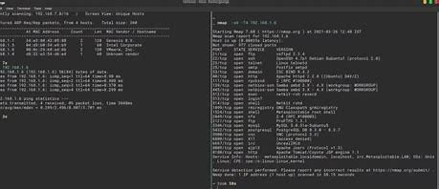
Nmap Command Options Overview Continued
-A description:
Enables aggressive scan options including OS detection and version detection.
-p description:
Specifies ports to scan. Uses -p- for a full scan.
--mtu 16 description:
Sets the maximum transmission unit to 16 bytes for evasion.
--badsum description:
Sends packets with incorrect checksums to bypass certain firewalls.

Slide 19
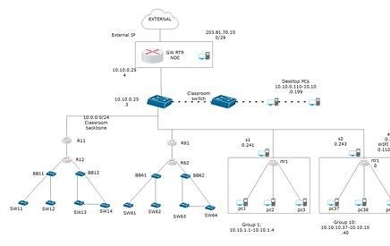
Nmap Command Options Overview Final
--data-length 500 description:
Adds 500 bytes of random data to packets to avoid detection.
-f description:
Fragment packets to evade firewalls and IDS.
-D RND:10 description:
Uses decoy scanning to mask the real source IP.

Slide 20
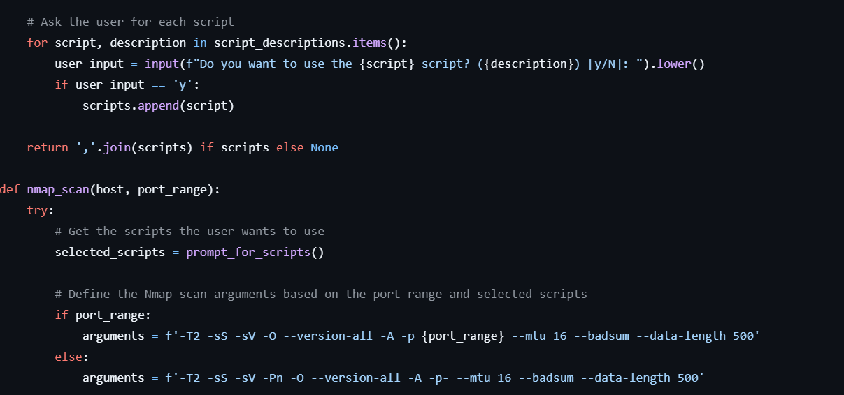
Script Execution and Output Handling
Running the Nmap Command
Command Construction:
Description: Combines the selected scripts and arguments to build the final Nmap command.
Subprocess Execution:
Description: Uses subprocess.Popen to execute the command and capture the output.
Extracting Results: CVEs and Metasploit Modules:
Uses regular expressions to find and extract CVEs and Metasploit modules from the output.

Slide 21
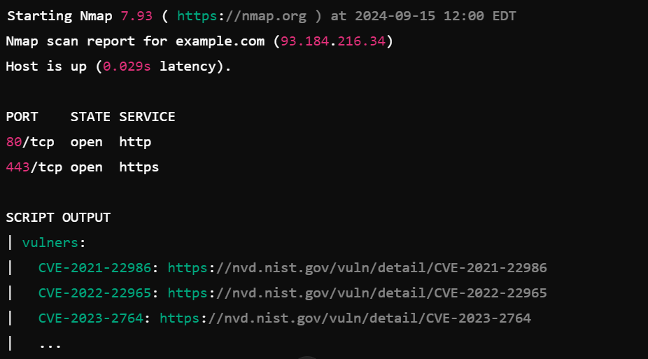
Example Command and Output
Command:
nmap -T2 -sS -sV -O --version-all -A -p 22,80 --mtu 16 --badsum --data-length 500 --script=http-honeypot,firewalk -f -D RND:10 192.168.1.1
Description:
Runs a scan on ports 22 and 80, using specific scripts and evasion techniques.
Output:
Description: Includes scan results, CVEs, and Metasploit modules if found.

Slide 22

Challenge yourself
Research Nmaps scripts you want to utilize at: NSEDoc Reference Portal: NSE Scripts — Nmap Scripting Engine documentation
Figure out some of the custom NSE scripts you would love to utilize, and create a script to automate the scanning process!

Slide 23
Questions?

Slide 24

Conclusion
Key Takeaways:
Nmap Vulnerability Scans offer comprehensive network security insights.
Proactive vulnerability assessment aids in identifying and mitigating risks.
Continuous learning and vigilance are crucial for effective cybersecurity measures.
Thank you!

